Slide 1


Decoding Revenue & Profit
The journey of a Rupee: From the Top Line to the Bottom Line.

Slide 2


The Top Line: Revenue
Revenue (also called Sales or the Top Line) is the total amount of money brought in by a company's operations.
It sits at the very top of the Income Statement.
It represents pure market demand. It is calculated before any expenses, taxes, or salaries are deducted.
Key Rule: A business can survive without profit for a short time, but it cannot survive without revenue. No sales = No business.

Slide 3

The Operational Pulse:
EBITDA
EBITDA stands for Earnings Before Interest, Taxes, Depreciation, and Amortization.
Why it matters: It shows how much cash the core business operations are generating. It strips out the accounting rules (depreciation) and financial structure (interest).
If EBITDA is negative, the core business model is flawed. The company is losing money just by opening its doors every morning.

Slide 4


The Core Earnings: Operating Profit (EBIT)
Subtracting the Wear & Tear
The True Operating Metric
Operating Profit (or EBIT - Earnings Before Interest & Taxes) is calculated by taking EBITDA and subtracting Depreciation & Amortization.
EBIT shows you the profit purely from operations, ignoring how the company is funded (Debt vs Equity) and ignoring government tax rates.
Depreciation accounts for the aging of physical assets (like factory machines breaking down over 10 years).
This allows you to accurately compare the operational efficiency of two companies in the same industry.

Slide 5
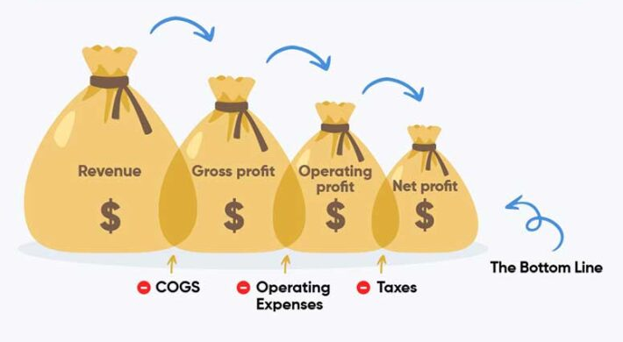
The Bottom Line: Net Profit
What Belongs to You
Net Profit (or Net Income) is the famous "Bottom Line". It is the final amount left over after absolutely every expense has been paid.
Cost of Goods Sold (COGS)
Operating Expenses & Salaries
Interest (paying the banks)
Taxes (paying the government)
This is the money that actually belongs to the shareholders. It can be reinvested into the company or paid out as Dividends.

Slide 6







The Efficiency Check: Profit Margins
Net Margin
Gross Margin
Operating Margin
Revenue minus the direct cost to make the product (COGS). Shows the raw markup power of a company's products.
EBIT divided by Revenue. Shows how efficiently management controls day-to-day business expenses like rent and salaries.
For every ₹100 of sales, how many rupees does the company actually keep as final profit?

Slide 7
Great Job on Day 13!
Tomorrow: Annual Reports.
Don't forget to Like, Share, and Subscribe!
/ @EarnJoyOfficial

